Slide 1
Diachronic analysis of language before, during and after 9-11-2001 attacks Data Semantics
Potertì Daniele 844892
Sanvito Alessio 844785
Sanvito Simone 844794
AA 2021/2022

Slide 2
Introduction
In popular culture, the attacks of September 11, 2001 represent a series of coordinated attacks against the United States, under the direction of the terrorist organization Al Qaeda.
The historical period in which we live is subject to many cultural, social but also linguistic changes.
In our analysis we decided to explore the diachronic change of the facts regarding this topic (9/11 attacks) over time, analyzing the period before, during and after 2001.

Slide 3
Goals
Did the attacks of 09/11/2001 affect the context in which some words are used and the meaning they assume?
How has the perception of everything about the words related to the bombers and related to the attacks changed over time?
Are there some terms that had never been used before the attacks and that took on a meaning immediately after them? What would have been their meaning in the previous period?

Slide 4
Workflow
04 - GloVe
01 - Periods choice
Models creation
Most similar words to a keyword
1996-2000 2001 2002-2006 (2016-2019)
Exploratory Analysis
01
05 - CADE
06
02
02 - Pre-processing
Alignment
Models creation Most similar words to a keyword Correspondence of words in different periods Similarity between two words Plots
Tokenization Stop words removal Word phrases Bigrams
05
03
04
03 - Word2Vec
06 - Results analysis
Models creation Most similar words to a keyword Correspondence of words in different periods Similarity between two words Plots

Slide 5
Word Embeddings
Word Embeddings are numeric vectors that represent a word. In our vocabulary each word will have a numeric vector associated.
Vector representations of words, i.e., word embeddings, are generated from a text corpus using a neural network [Mikolov+, 2013]
You shall know a word by the company it keeps (“Studies in linguistic analysis”, 1057)
Based on the distributional hypothesis of semantics, words that are more similar to each other are going to be used together more often.
Notes:
Come strumento principale abbiamo utilizzato le word embeddings
Sono vettori numerici che rappresentano una parola
Sono importanti perché confrontandoli con altri vettori è possibile fare delle inferenze
Le parole simili sono usate insieme

Slide 6
Word2Vec
Word2Vec is a 2-layer neural network to generate word embeddings given a text corpus
The representation of a word in Word2Vec is generated by considering the words that co-occur in its context
predicts target word from context (CBOW) or context from target word (SKIP-GRAM)
Word2Vec represents words in a vector space in which similar words are close one to each other
Usually via cosine similarity
Vector components are difficult to interpret
Notes:
Con la rete di wor2vec è possibile, partendo da un corpus, generare word embeddings

Slide 7
GloVe
GloVe is an unsupervised learning algorithm for obtaining vector representations for words. Training is performed on aggregated global word-word co-occurrence statistics from a corpus, and the resulting representations showcase interesting linear substructures of the word vector space.
Word2Vec takes texts as training data for a neural network. The resulting embedding captures whether words appear in similar contexts. GloVe focuses on word co-occurrences over the whole corpus. Its embeddings relate to the probabilities that two words appear together.

Slide 8
CADE
Word meaning is not static and depends on the context in which words are used.
CADE is a general framework to support cross-corpora language studies with word embeddings, where embeddings generated from different corpora can be compared to find correspondences and differences in meaning across the corpora.

Slide 9
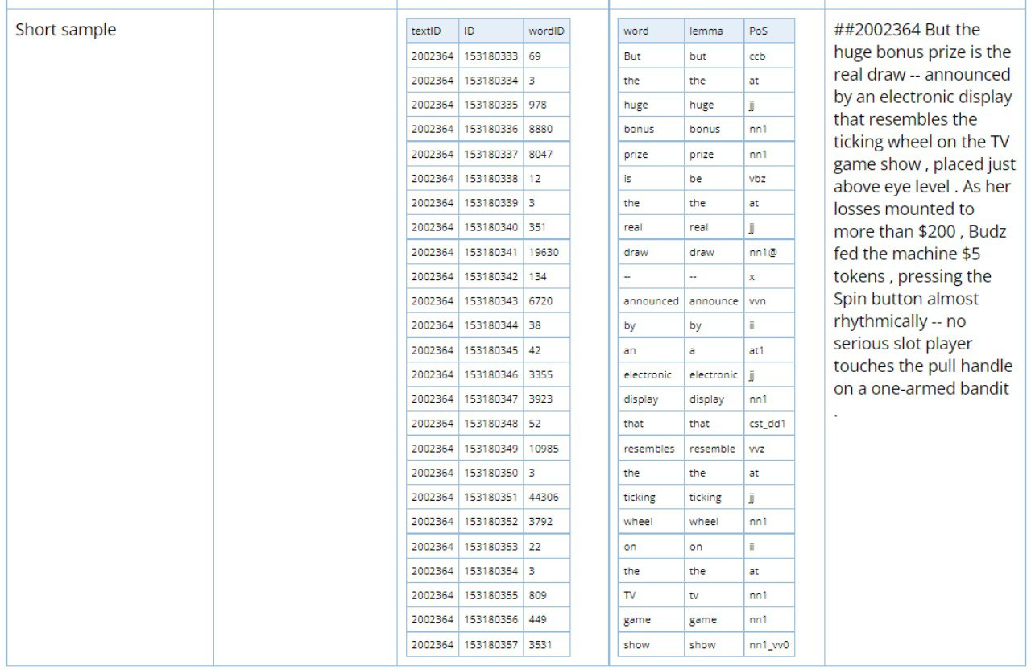
Corpus
The corpus we have used for our analysis is Corpus Of Contemporary American English (COCA); this corpus is divided in different parts, where every part is a different category (Academic, Blogs, Fiction, Magazine, Movies, Newspaper, Spoken).
In each category there are different files grouped annually (since 1990 until 2019) in three formats:
db (ID of a word is associated to a general ID)
wlp (word, lemma and part of speech tag in vertical format)
text (the entire text of every article of an year represented by its ID).

Slide 10
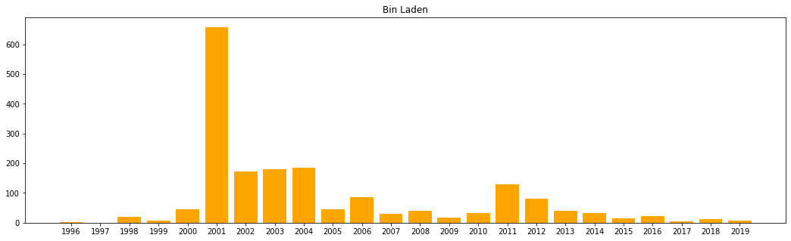
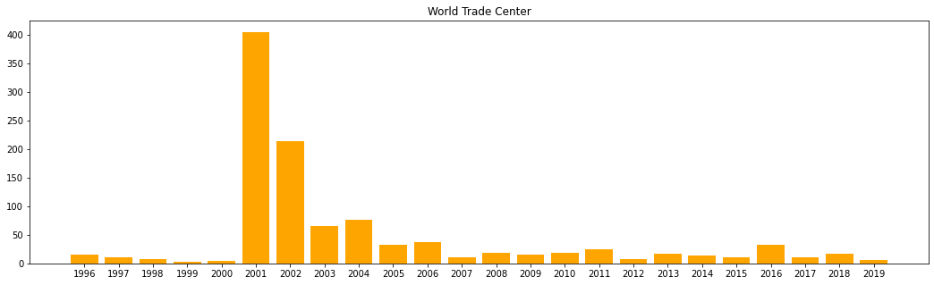
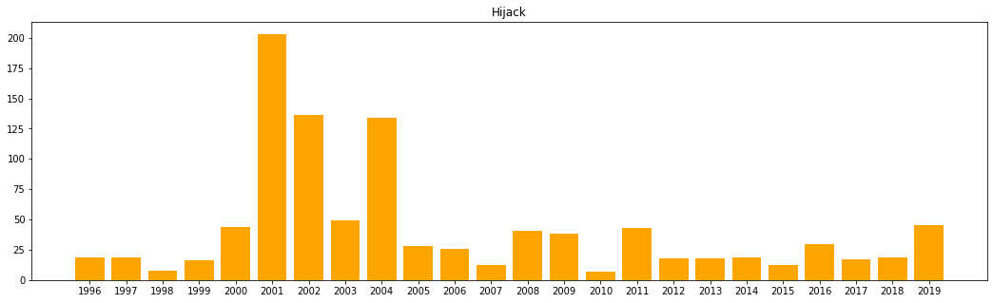
Exploratory Analysis (1)
At first we made an exploratory analysis of the frequency of the keywords we have chosen. For every keyword we have tried to find out the number of times that this keyword has been used in the articles, analyzing it year by year. Results can be seen in the plots on the right.

Slide 11
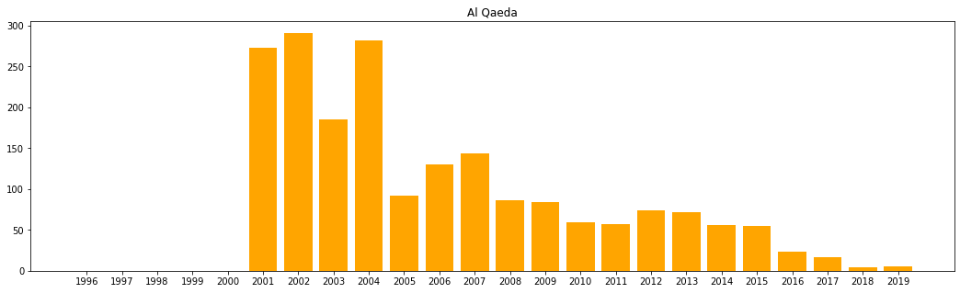
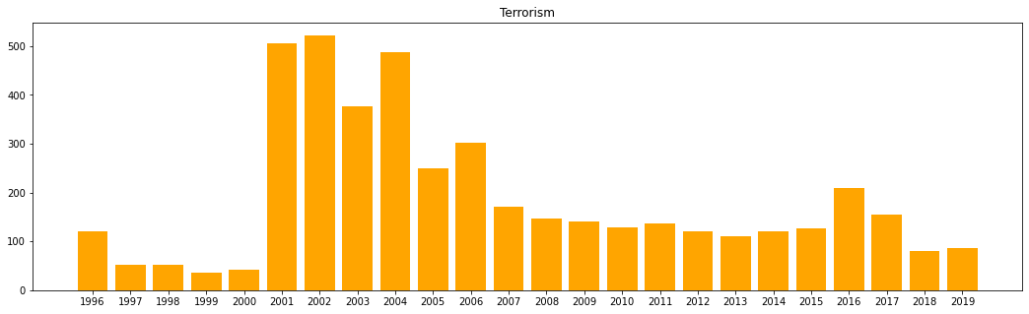
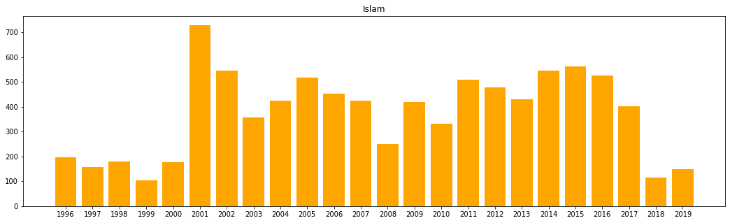
Exploratory Analysis (2)
At first we made an exploratory analysis of the frequency of the keywords we have chosen. For every keyword we have tried to find out the number of times that this keyword has been used in the articles, analyzing it year by year. Results can be seen in the plots on the right.

Slide 12
Pre-processing (1) These steps have been done for all of the periods chosen.
Steps
Tokenization
Stop words removal
Lemmatization
Topic Modeling
Selection of the articles which contain the keywords
Pre-processing on these articles (tokenization, stop words removal, word forms for keywords, word phrases construction)

Slide 13
Pre-processing (2)
Tokenization
Tokenize a text means to divide it into minimal units of analysis, tokens
Stop words removal
After tokenizing, tokens about stop words and punctuation (except the dot) have been removed
Lemmatization
Tokens have been lemmatized in order to have the basis form of the words: this procedure limited us in the analysis of pre and post event articles. Limitations were in terms of number of years to use (we were able to use only two years as interval of pre and post) and in terms of time and computational ability required: we decided to proceed without using the lemmatization .

Slide 14
Pre-processing (3)
Topic modeling (LDA)
Once the articles were pre-processed, a search process was carried out for the most used tokens, the most frequent topics through LDA; then we wanted to use those tokens as keywords in the subsequent phases of the work. The results obtained, however, returned very generic tokens (for example "say", "be", etc.), so it was decided not to use those tokens, but to choose keywords "empirically".
Articles selection Therefore, words considered to be the most important and most inherent in the articles concerning the attacks were selected, using, where possible, also the word form of words (all the possible forms of a word). Starting from the unprocessed data, all the articles containing at least one of the keywords were selected and were subsequently used in the analyses.

Slide 15
Pre-processing (4)
Pre-processing on the final group of articles
After selecting the articles, the tokenization operations including removal of stop words and removal of non-alphanumeric signs, such as punctuation marks (except for dots), were performed again.
So each article has been saved in a dictionary in which the article id represents the key and the value is represented by the list of sentences (each sentence is saved in a list) that make up the article.
Subsequently, in order to use words such as "Bin Laden" or "Twin Towers" word phrases were formed; these were then added to the vocabulary.

Slide 16
Creation of the models
Word2Vec
minimum of 15 words to select most used words
vector size of 300, it is commonly used and gives the best results
sg=1, we used Skip-gram method because it predicts surrounding words given the current word and works well on semantic tasks
5 iterations over corpus is a good solution both for stability and for computational cost (and capacity)
plots to show similar words
We used three different models to achieve our goals:
Word2Vec (no alignment)
GloVe (no alignment)
CADE
The results of the pre-processing have been given as input to these three models.
GloVe
corpus fit with window = 3
epochs equals to 40
4 as number of threads
CADE
for each period we have aligned the corpora and then we made the analyses
plots to show contextual variability and similar words were produced

Slide 17
Did the attacks of 09/11/2001 affect the context in which some words are used and the meaning they assume?

Slide 18
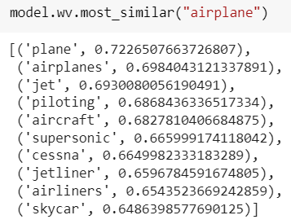
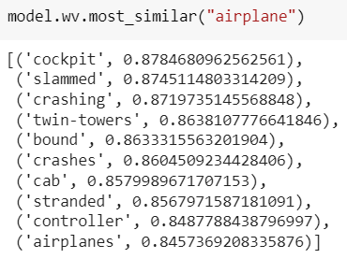
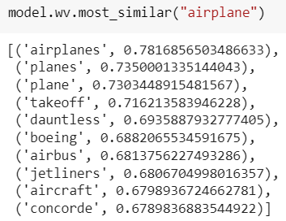
GloVe and CADE do not give as “most similar words” any related to this specific terrorist attack.
Word2Vec Airplane
1996-2000
2001
2002-2006
In this period most similar words are referred to the specific field of airplanes
In 2001 we have more references to crashes (because of the terrorist attack) and a high correlation with “Twin Towers”
In 2002-2006 we have that the most similar words don’t refer anymore to the attack

Slide 19
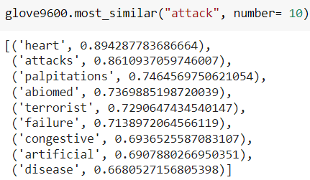
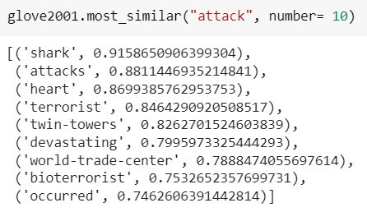
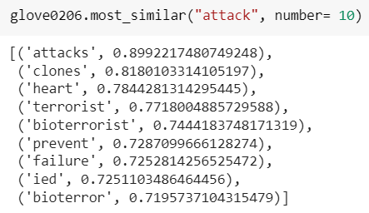
GloVe Attack
1996-2000
2001
2002-2006
Here we can see that in all the period there are several references to the word attack in general (heart, shark, terrorist etc.). In 2001 there are clear results derived from the hijack; in 2002-2006 the similar words go back to the initial ones , even if there is a stronger link to terrorist-related terms (probably because of the increasing attention to terrorism).
Word2Vec & CADE have no specific references to the 9/11 attack, but the most similar terms result to be related generically to terrorist aspects.

Slide 20
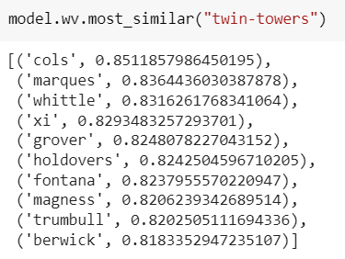
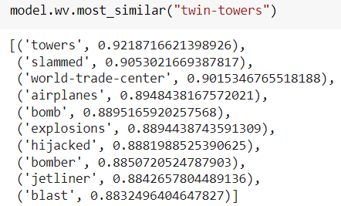
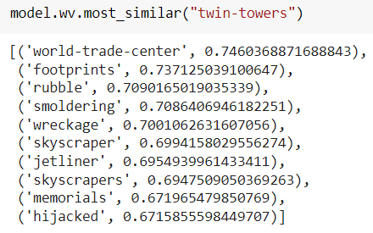
Word2Vec Twin Towers
1996-2000
2001
2002-2006

Slide 21
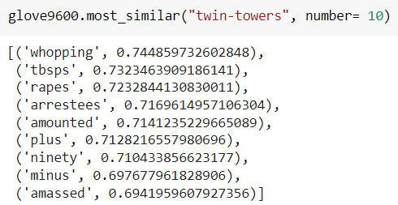
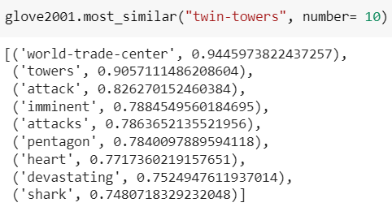
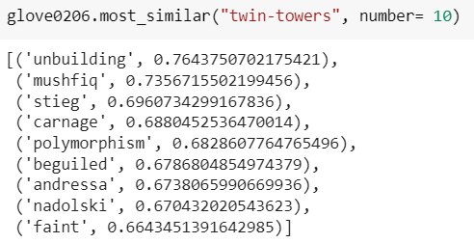
GloVe Twin Towers
1996-2000
2001
2002-2006
For Word2Vec, GloVe and CADE we can assert the same things: pre 2001 there are various words similar to twin towers, with no apparent sense. In 2001 the similar words are strongly related to the 9/11 attack. Post 2001 the most similar words seem to be random words except from some which could be derived from the attack, such as smoldering, memorials, hijacked in Word2Vec and carnage, unbuilding and maybe faint in GloVe.

Slide 22
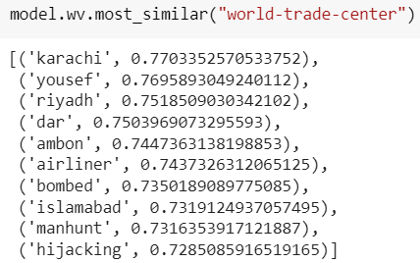
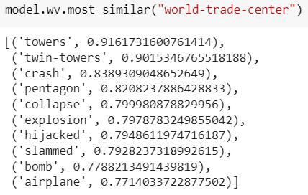
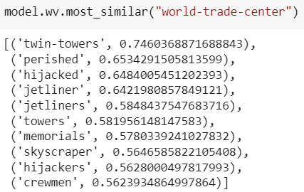
Word2Vec World Trade Center
1996-2000
2001
2002-2006
In this period it seems difficult to find a logic connection between these words: in reality we can notice that there could be an influence derived from Ramzi Ahmed Yousef’s terrorist attack at World Trade Center in 1993
In 2002-2006 period most similar words to World Trade Center are still influenced by events inherent to September 11 attacks: plus, there is for the first time a reference to some kind of memorial
In 2001 all the similar words are strongly related to terrorist attacks, or more specifically, to September 11 attacks

Slide 23
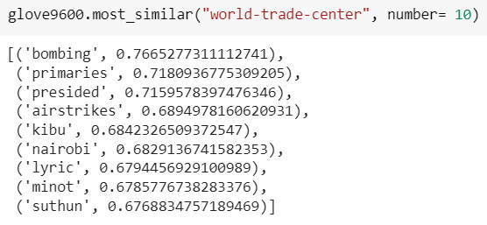
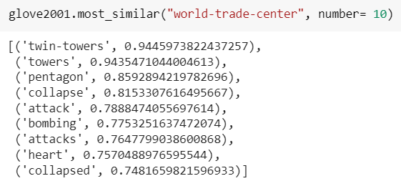
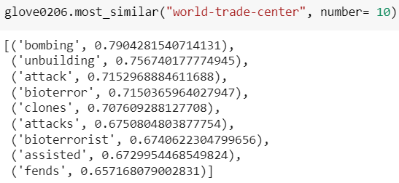
GloVe World Trade Center
1996-2000
2001
2002-2006
We can affirm that there is a sort of semantic shift of the meaning of this trigram: it changes starting from a context of bombs (because of 1993 attack), evolving in a context dependent on September 11 attacks and concluding with a context that has terrorism (in general) as its main topic.
GloVe results are not substantially different from the ones found with Word2Vec

Slide 24
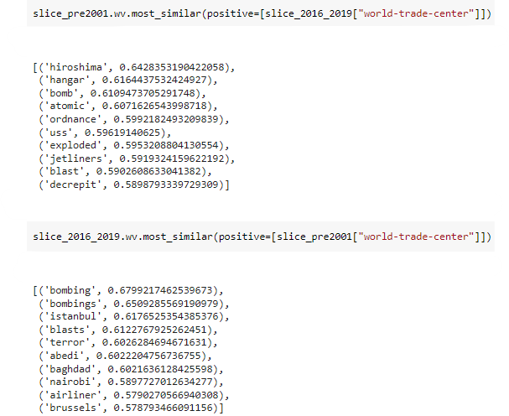
CADE World Trade Center (1996-2019)
In 1996 Hiroshima Peace Memorial has been inaugurated so we have this reference probably because in 2016 WTC memorial has been inaugurated
In the slice pre 2001 we have many references to the 1993 World Trade Center bombing so we have again this dimension of terrorism

Slide 25
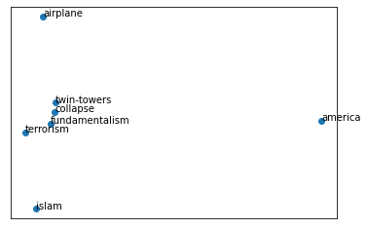
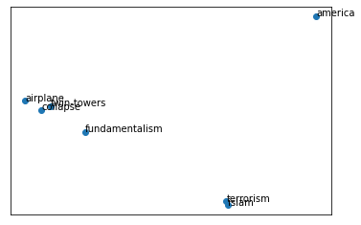
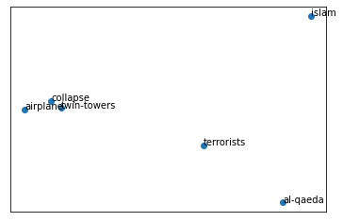
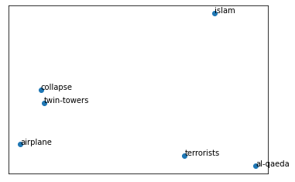
1996-2000 vs 2001
2001 vs 2002-2006
Semantic shift - Contextual Variability

Slide 26
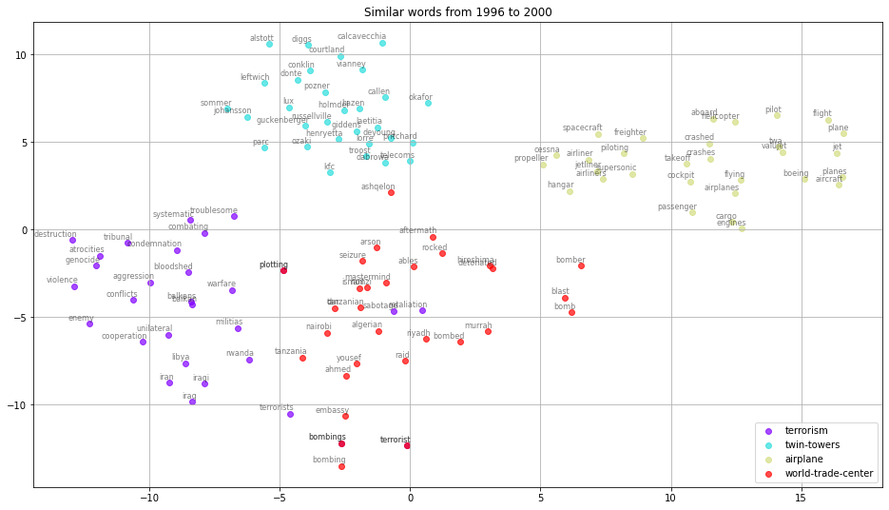
Pre 2001

Slide 27
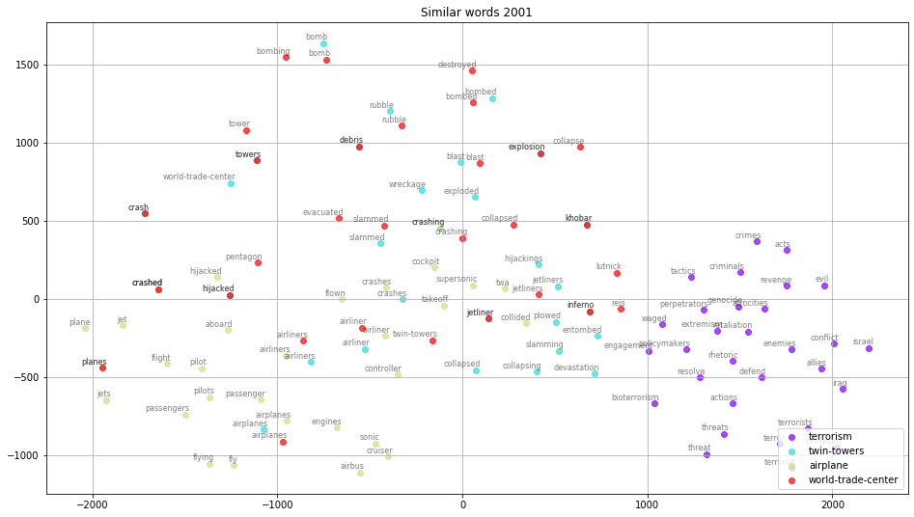
2001

Slide 28
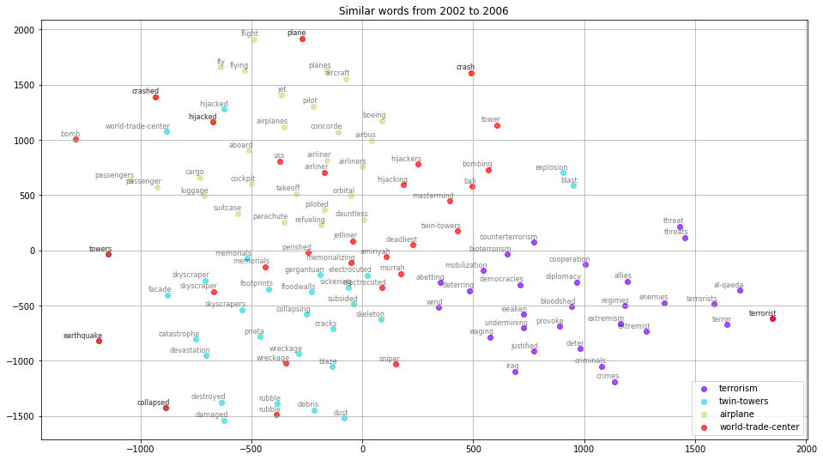
Post 2001

Slide 29
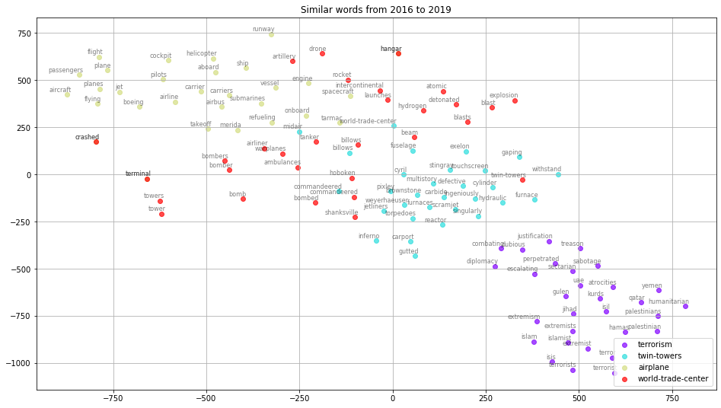
2016-2019

Slide 30
How has the perception of everything about the words related to the bombers and related to the attacks changed over time?

Slide 31
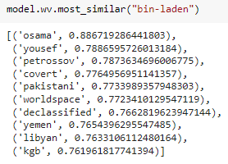
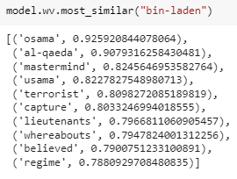
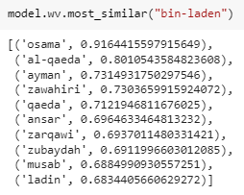
Word2Vec Bin Laden
1996-2000
2001
2002-2006
Slight change, some words related to terrorism
GloVe Bin Laden
Similar results

Slide 32
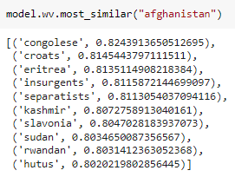
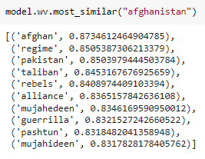
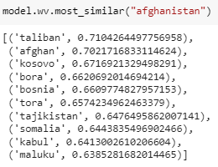
Word2Vec Afghanistan
2001
Similar words to the ones of the precedent period; focus more on the division in mujaheddin and talibans
2002-2006
Terms about place with high tension in that period
1996-2000
Words about the ongoing war in Afghanistan to eradicate the Soviets from the territory

Slide 33
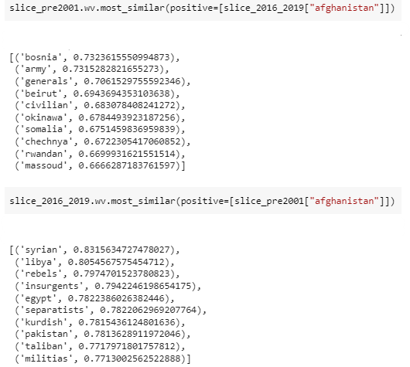
GloVe Afghanistan → no significant results
CADE Afghanistan
In the period 2016-2019 the word Afghanistan is in the context of other words, mainly places, where in pre 2001 there was the American war or occupation (okinawa).
In pre 2001 Afghanistan has a semantics that if translated into the context of 2016-2019 leads to a similarity to words related to places where there is the presence of separatists or paramilitary militias and places in the Middle East

Slide 34
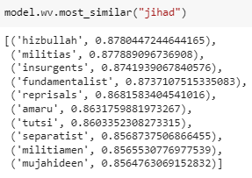
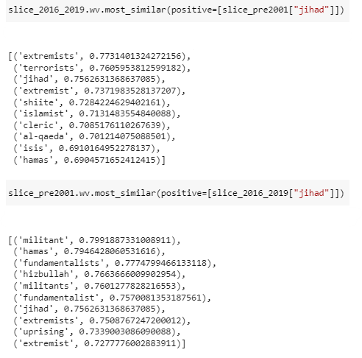
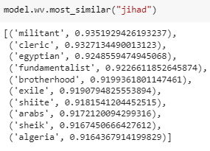
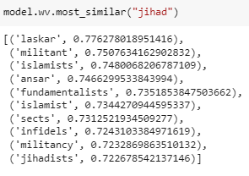
Word2Vec Jihad
GloVe Jihad Same results of Word2Vec & CADE
CADE Jihad
1996-2000
There is not a big change at the semantic level, the terms are always referring to paramilitary movements and religious fundamentalism
2001
2002-2006

Slide 35
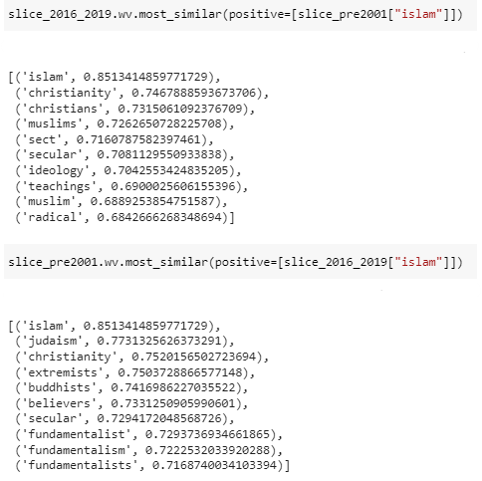
Word2Vec & GloVe Islam
Results are not clear, some words are not understandable
CADE Islam
In pre 2001 Islam has a meaning that when translated into post 2001 (2016-2019) is similar to words that refer to religious terms
In 2016-2019 Islam has a meaning that, if translated into pre 2001, is similar to religious words, but we note the presence of words that refer to extremism and fundamentalism. Its semantics is linked to severe doctrines

Slide 36
Are there some terms that had never been used before the attacks and that took on a meaning immediately after them? What would have been their meaning in the previous period?

Slide 37
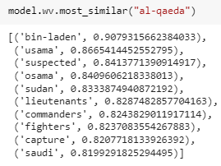
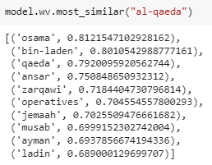
Word2Vec & GloVe - Al Qaeda
We can notice (even from the exploratory analysis) that the word al-qaeda is not in the vocabulary before the attacks.
During 2001 the meaning associated is in the context of military activities; in 2002-2006 this shade related to military activities and terrorism persists
2001
2002-2006
With GloVe the results are similar to the ones of Word2Vec, there is not a big change from 2001 to 2002-2006

Slide 38
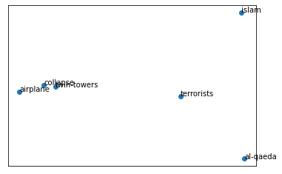
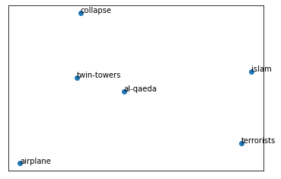
CADE - Al Qaeda
Even with the alignment of CADE the results of the “Most similar” are pretty similar to the ones obtained with Word2Vec.
To “visualize” the shift of meaning of the word, an interesting idea has been to plot the contextual variability of it (between 2001 and 2016-2019).
2016-2019
2001

Slide 39


CADE - Al Qaeda
So it seems that nowadays the meaning of al qaeda is related to the one of twin towers; what would have been the meaning in the years before the terrorist attacks?
Considering both the meaning in 2001 and the one in the most recent period, it would have been something similar to militants and terrorists, highlighting the character of this organization.

Slide 40
Possible future implementations
Try to use more recent data, the ones from 2020 to 2022 or to consider longer intervals for pre and post (both are periods of 5 years)
Use other algorithms (like BERT) to see if the results change significantly, using also sentence embeddings
Try to use different input parameters for the models or try to train more than one model to increase the stability of its results

Slide 41
References
Survey of Computational Approaches to Lexical Semantic Change Detection. Nina Tahmasebi, Lars Borin, Adam Jatow, 2019.
Analysing Lexical Semantic Change with Contextualised Word Representations. Mario Giulianelli, Marco Del Tredici, Raquel Fernandez, 2020.
Using Word Embeddings for Journalistic Research, https://towardsdatascience.com/using-word-embeddings-as-a-method-for-journalistic-research-ae82ffea7a62
Topic Modeling in Python: Latent Dirichlet Allocation (LDA) https://towardsdatascience.com/end-to-end-topic-modeling-in-python-latent-dirichlet-allocation-lda-35ce4ed6b3e0
Dynamic Word Embeddings for Evolving Semantic Discovery, arXiv:1703.00607v2, Yao et al, 2018, https://arxiv.org/pdf/1703.00607.pdf
Compass-Aligned Distributional Embeddings For Studying Semantic Differences Across Corpora - Bianchi F., Di Carlo V., Nicoli P. and Palmonari M.
Jeffrey Pennington, Richard Socher, and Christopher D. Manning. 2014. GloVe: Global Vectors for Word Representation.

Slide 42
Thanks!
Potertì Daniele
Sanvito Alessio
Sanvito Simone

